Slide 1
Gatekeeping under Congestion: An Empirical Study of Referral Errors in the Emergency Department
SMU – 23rd Feb 2018
Michael Freeman INSEAD
Joint work with:
Susan Robinson – Cambridge University Hospitals
Stefan Scholtes – Cambridge Judge Business School

Slide 2
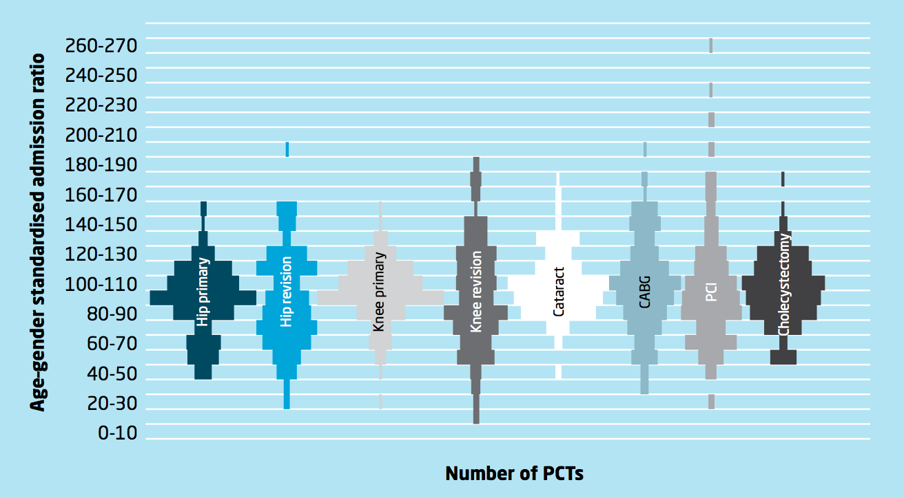
Huge variation in health care use
The King’s Fund. Variations in Healthcare. 2011.

Slide 3
Warranted variation?
Clinical need
Medical guidelines
Informed patient choice
Innovations in treatment or care

Slide 4

Other sources of variation
Clinical decision making
Supply-sensitive
e.g. availability of beds, specialists,…
Financial incentives
“The doctor’s pen is the most expensive
item in a hospital”
Dr Gareth Goodier
Former CEO of Cambridge University Hospitals

Slide 5
Decision making in the ED
Emergency providers make disposition decisions ~350,000 times/day in US EDs
Option 1: admit patient to hospital
Option 2: discharge patient home
→ ED physicians act as gatekeepers to inpatient beds
Significant variation in admission rates (gatekeeping referral rates) across EDs:
Pines at al. (2013 MCRR): US ED admission rate varied from 9.8% to 25.8% at the 10th and 90th percentiles
MCRR: Medical Care Research and Review

Slide 6
Gatekeeping (GK) Process
Specialist
Service
Initial
diagnosis
of needs
/preferences
Arrival
Service
configuration
GK
Service
Exit
Information about needs
Service configuration decision depends on customer needs & preferences
Chance of specialist referral depends on customer complexity
Trade-off (Shumsky and Pinker 2003)
Cost of specialist time
Cost of failing to resolving customer’s problem
GP systems pervasive beyond healthcare
Call centers, maintenance, restaurant waiting

Slide 7
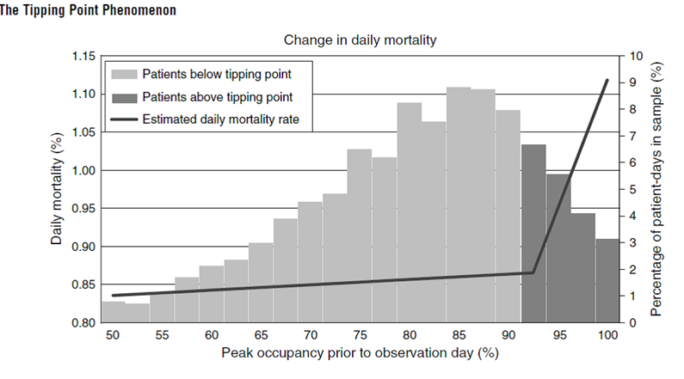
Problems with hospital admission
Hospitals are dangerous places
Lack of mobility → physical and mental deterioration
Adverse events → infections, falls, medication errors
Hospital admission is expensive
Capacity (e.g. beds) is limited
Unnecessary admission exposes other patients to risk
Kuntz et al. (Management Science 2015)
[~80,000 patients with STR,AMI,CHF,GIH,PNE,NOF]

Slide 8
The admission trade-off
Admission ＋
If patient unwell, increases chance of them receiving appropriate treatment
If problem not clear, increases chance of receiving more accurate diagnosis
Admission –
Exposes patient to risk of hospital incident
Increases hospital crowding, exposing patients already in hospital to increased safety risk
Uses an expensive and constrained resource, may prevent another `more needy’ patient from getting a bed

Slide 9
Challenges for gatekeeping in the ED
Emergency medicine: High levels of clinical uncertainty and variation in diagnostic accuracy
Decision density high → can lead to elevated cognitive loading
Graber et al. (AIM 2005): cognitive factors contributed in 74% of cases of diagnostic error in the ED
ED physicians under increasing time and workload induced pressure
US (1997 to 2007): ED visits grew at almost twice the rate of population growth
UK (1997 to 2012): ED visits grew by 47% compared to population growth of 10%
AIM: Archives of Internal Medicine

Slide 10
Research questions
RQ1: How does congestion affect the accuracy of ED gatekeeping decisions?
Wrongful discharges (false negative)
Avoidable hospitalizations (false positive)
ED congestion
Wrongful discharge?
Yes
No
Admit patient?
No
Avoidable hospitalization?
Yes
Yes
No

Slide 11
Research questions
RQ2: Are there process changes that can improve the accuracy of gatekeeping decisions?
Two-stage gatekeeping system
Yes
Wrongful discharge?
No
Admit patient?
No
Disposition decision is clear?
Yes
Yes
Yes
Avoidable hospitalization?
No
No
Patient referred for 2nd opinion
Single-stage gatekeeping system

Slide 12
Related literature
Gatekeeping
Shumsky & Pinker (2003) and Hasija et al. (2005): contracting for system optimal rate of referrals
Lee et al. (2012) and Zhang et al. (2011): outsourcing contracts and security-check performance
Freeman et al. (2016): study of workload induced changes in gatekeeping decisions in maternity care
Type classification
Argon & Ziya (2009): model customer classification policies with imperfect information about customer type
Alizamir et al. (2013) and Wang et al. (2010): increasing service duration can improve accuracy of diagnosis, at cost of increased congestion
Speed, quality & load
Anand et al. (2011) and Kostami & Rajagopalan (2013): service value increasing in duration, but cost of wait
Hopp et al. (2007): increasing capacity may increase congestion as discretionary service components added
Debo et al. (2008) and Paç & Veeraraghavan (2015): congestion acts as a deterrent to expert overtreatment
Streaming/triage
Saghafian et al. (2012, 2014, 2017): triage can be augmented to stream ED patients based not only on their severity but also e.g. their complexity

Slide 13
Data
All visits to the ED of a large UK-based teaching hospital over a 7 year period (2007-2013)
Approx. 250 patient visits per day; 29% of patients admitted
Data set includes all inpatient info associated with those patients admitted via the ED
Subset to approx. 500k obs. of patients over the age of 16 who did not leave without being seen
Exclude dates around public holidays when ED staffing and patient arrivals atypical
Use first year of data as a run-in period to generate controls and measures of patient risk
Leaves ~374k obs. for analysis

Slide 14
Outline model
(RQ1: How does congestion affect the accuracy of ED gatekeeping decisions?)
Wrongful discharges
Avoidable hospitalizations
Total errors = wrongful discharges + avoidable hospitalizations
Next few slides:
Dependent variables (false positives and false negatives)
Independent variable (time pressure)
Controls
Model error structure

Slide 15
Dependent variables
Wrongful discharges
Patient discharged home from ED but revisits ED within 7 days and is then admitted to the hospital
1.0% of ED visits and 1.5% of all patients discharged
Avoidable hospitalizations
Patient admitted to an inpatient unit and discharged within 24hrs without treatment
4.3% of ED visits and 13.7% of all admissions
Change in rate indicative of change in likelihood of false admissions

Slide 16
Independent variable
The IV of interest in this study is congestion. Why?
Waiting time targets in UK ED’s mean congestion and service time highly correlated:
95% of patients must be out of ED within 4 hours of arrival
Failure to achieve this in any month attracts a fine of £200 per breach
“When we are crowded we have two competing problems - we know we should not admit patients unnecessarily, yet we have to avoid breaching the ED waiting time target. At the moment avoiding a breach seems to be of higher priority”

Slide 17
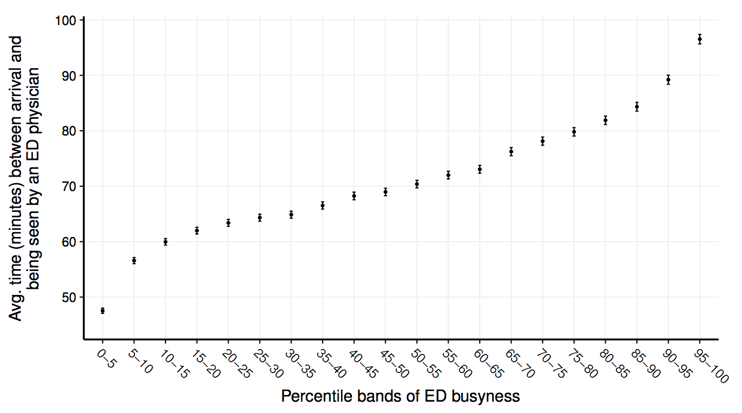
Congestion creates time pressure
Time available for service before breaching 4 hour target reduces with ED congestion.
~25% reduction in avg. time available for diagnosis between first to last %ile bands
Consequence: ED physicians must make gatekeeping decisions under increased time pressure & uncertainty

Slide 18
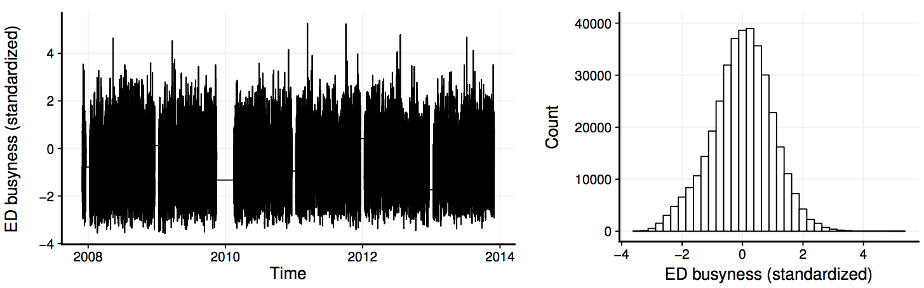
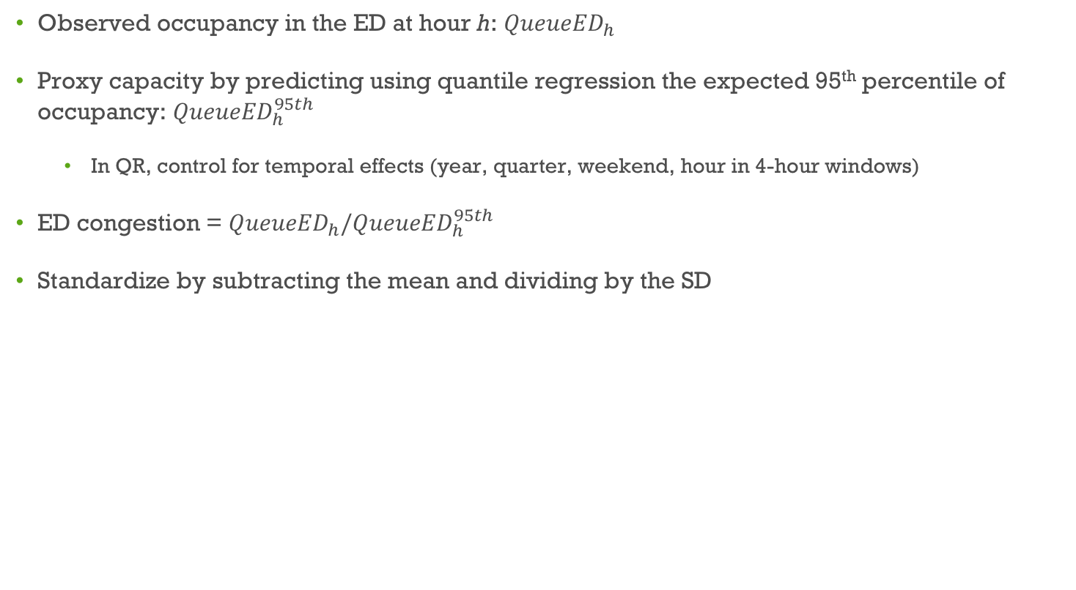
Measuring congestion
Observed occupancy in the ED at hour h: ${QueueED}_{h}$
Proxy capacity by predicting using quantile regression the expected 95th percentile of occupancy: ${QueueED}_{h}^{95th}$
In QR, control for temporal effects (year, quarter, weekend, hour in 4-hour windows)
ED congestion = ${{QueueED}_{h}/QueueED}_{h}^{95th}$
Standardize by subtracting the mean and dividing by the SD

Slide 19
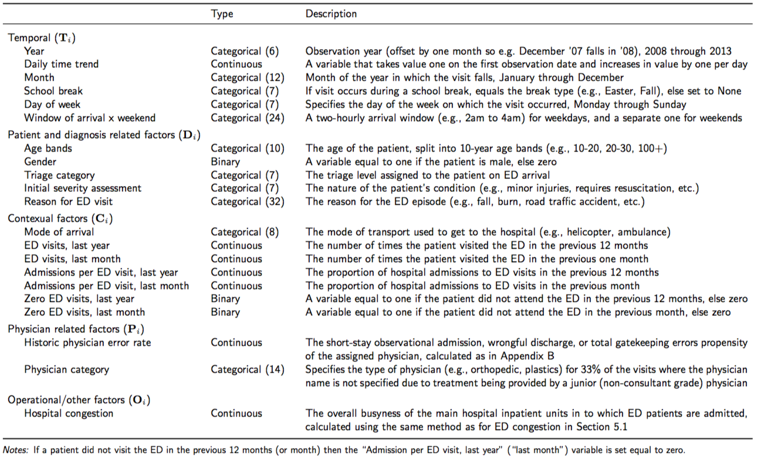
Controls

Slide 20
Hypotheses 1 & 2: Gatekeeping accuracy
RQ-1: How does congestion affect the accuracy of gatekeeping decisions
Congestion induces time pressure that reduces accuracy of diagnosis (e.g. Alizamir et al. 2013) meaning that ED physicians have to make gatekeeping decisions under increased clinical uncertainty
ED physicians adjust their service to trade off time spent with an individual patient versus improved system throughput
Hypothesis 1 (error-making hypothesis)
As system congestion increases, ED physicians make more errors in their referral decisions
Clinical uncertainty: increases classification errors
Cognitive overloading: impairs medical decision making
Hypothesis 2 (over-response hypothesis)
As system congestion increases, there will be an increase in the rate of avoidable hospitalizations relative to wrongful discharges, since ED physicians weight the cost of the latter more heavily
Asymmetric disutilities: “No-one has ever been sued for admitting a patient to hospital”
Safety first principle: Minimize risk of a “catastrophe”

Slide 21
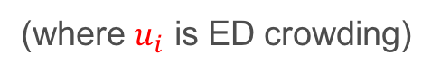
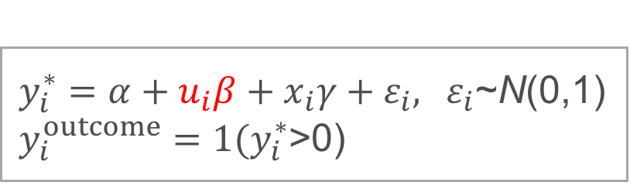
Model: Standard probit
Tot.
Error
Disch.
Error
Adm.
Error
ED congestion
1
1
0
Wrongful discharge?
Yes
No
Admit patient?
No
0
0
0
Yes
1
0
1
Yes
Avoidable hospitalization?
No
0
0
0
$y_{i}^{∗}=α+u_{i}β+x_{i}γ+ε_{i},{ ε}_{i}$~N(0,1)
$y_{i}^{outcome}=1(y_{i}^{∗}$>0)
(where $u_{i}$ is ED crowding)

Slide 22
Modeling challenge
ED congestion
Wrongful discharge?
Yes
No
Admit patient?
No
Disposition decision is clear?
Yes
Yes
Yes
Avoidable hospitalization?
No
No
Patient referred to CDU

Slide 23
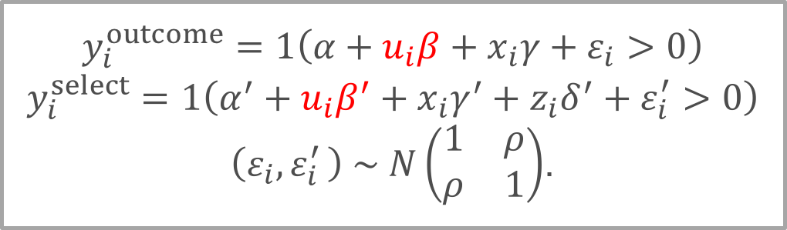
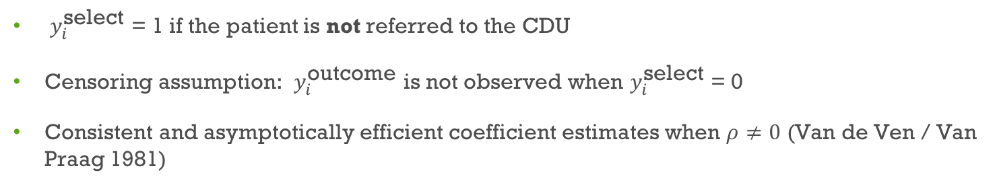
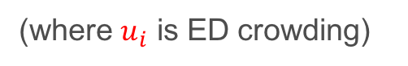
Heckman probit model
$$y_{i}^{outcome}=1\left(α+u_{i}β+x_{i}γ+ε_{i}>0\right)$$
$$y_{i}^{select}=1\left(α^{′}+{u_{i}β^{′}+x_{i}γ^{′}+z}_{i}δ^{′}+ε_{i}^{′}>0\right)$$
$\left(ε_{i}{,ε}_{i}^{′}\right) \sim N\left(\begin{matrix}1 & ρ \\ ρ & 1\end{matrix}\right)$.
(where $u_{i}$ is ED crowding)
$y_{i}^{\text{select}}$ = 1 if the patient is not referred to the CDU
Censoring assumption: $y_{i}^{\text{outcome}}$ is not observed when $y_{i}^{\text{select}}$ = 0
Consistent and asymptotically efficient coefficient estimates when $ρ≠0$ (Van de Ven / Van Praag 1981)

Slide 24
Instrumental variables (I)
Model estimation improved and coefficients more reliable when IVs provided
IV 1: Propensity of assigned ED physician to refer patients into CDU over previous year
Relevance:
If a patient is assigned to a physician who has a history of referring more patients to the CDU, they are more likely to be referred there themselves
Validity:
Include controls for the physician’s historic error rates over the same period
After controlling for physician-specific historic error rates, the CDU referral rate of the assigned physician is uncorrelated with the residuals

Slide 25
Instrumental variables (II)
Model estimation improved and coefficients more reliable when IVs provided
IV 2: Congestion level in the CDU
Relevance:
If the CDU is congested then it becomes less available to ED physicians as an option
Validity:
For patients who are not admitted to the CDU, the busyness of the CDU should have no direct effect on their likelihood of being admitted or discharged in error
(Instrument validity can be tested with several instruments → all tests pass)

Slide 26
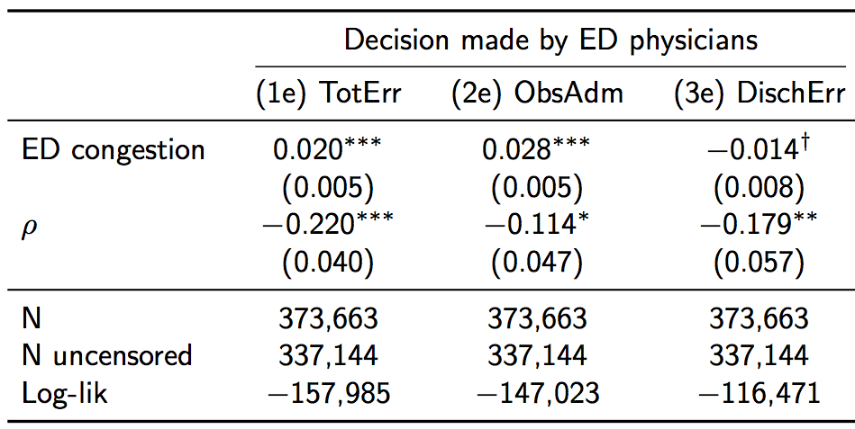
Congestion effect
A 1σ increase in ED congestion results in a:
7.2% increase in both types of error
7.7% increase in avoidable hospitalizations
3.3% reduction in wrongful discharges
Consistent with Hypotheses 1 and 2

Slide 27
Hypothesis 3: Two-stage gatekeeping
RQ-2: Are there process changes that improve the accuracy of gatekeeping decisions?
Hypothesis 3 (uncertainty-based streaming)
A two stage gatekeeping system reduces both types of gatekeeping error
The two-stage GK system improves the match between customers with heterogeneous needs with gatekeepers with heterogeneous experience and resources
Streaming/triage
Assigning customers different priority classes may be beneficial when they differ sufficiently in their service requirements – e.g. Mandelbaum & Reiman (1998), Dijk & Sluis (2008)
Saghafian et al. (2012) and Saghafian et al. (2014): triage can be augmented to stream ED patients based not only on their severity but also using their (i) likelihood of being admitted and (ii) their complexity

Slide 28
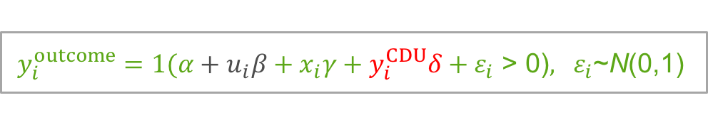
Two-stage gatekeeping system
Wrongful discharge?
Yes
No
Referral decision made in ED
Admit patient?
No
Yes
Yes
Yes
Avoidable hospitalization?
Disposition decision is clear?
No
Unobservables
Wrongful discharge?
Yes
No
No
Referral decision made in CDU
Admit patient?
No
Yes
Avoidable hospitalization?
Yes
$y_{i}^{outcome}=1(α+u_{i}β+x_{i}γ+y_{i}^{CDU}δ+ε_{i}$ > 0)$,{ ε}_{i}$~N(0,1)
No

Slide 29
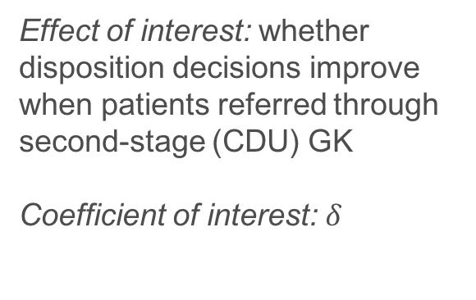
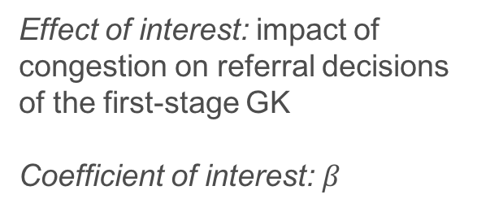
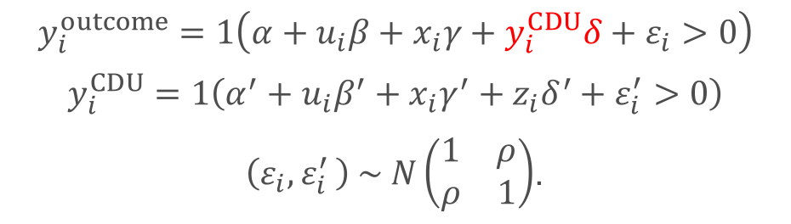
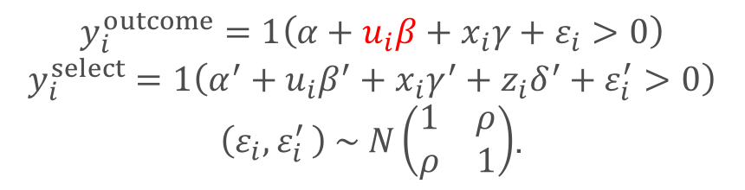
Recursive bivariate probit
Heckprobit
Effect of interest: impact of congestion on referral decisions of the first-stage GK
Coefficient of interest: $β$
$$y_{i}^{outcome}=1\left(α+u_{i}β+x_{i}γ+ε_{i}>0\right)$$
$$y_{i}^{select}=1\left(α^{′}+{u_{i}β^{′}+x_{i}γ^{′}+z}_{i}δ^{′}+ε_{i}^{′}>0\right)$$
$\left(ε_{i}{,ε}_{i}^{′}\right) \sim N\left(\begin{matrix}1 & ρ \\ ρ & 1\end{matrix}\right)$.
Recursive bivariate probit
$$y_{i}^{outcome}=1\left(α+u_{i}β+x_{i}γ+y_{i}^{CDU}δ+ε_{i}>0\right)$$
$$y_{i}^{CDU}=1\left(α^{′}+{u_{i}β^{′}+x_{i}γ^{′}+z}_{i}δ^{′}+ε_{i}^{′}>0\right)$$
$\left(ε_{i}{,ε}_{i}^{′}\right) \sim N\left(\begin{matrix}1 & ρ \\ ρ & 1\end{matrix}\right)$.
Effect of interest: whether disposition decisions improve when patients referred through second-stage (CDU) GK
Coefficient of interest:$δ$

Slide 30
Benefits of two-stage gatekeeping system
 | No patient routed through CDU | All patients routed through CDU
Avoidable hospitalizations | 5.23% | 1.76%
Wrongful discharges | 1.16% | 0.67%
Avg. treatment effect (ATE)
Avoidable hosp. = -3.5%
Wrongful discharges = -0.49%
Avg. treatment effect on the treated (ATT)
Avoidable hosp. = -9.3%
Wrongful discharges = -1.2%
When patients routed through the two-stage system both errors go down
ED physicians especially good at identifying patients who would benefit most from CDU second opinion

Slide 31
More ED or CDU capacity?
Counterfactual: redeploy CDU capacity to the ED to reduce crowding
1.5m patient hours in ED
326,000 patient hours in CDU (=20% of ED hours)
If there is no CDU, then adding 20% more capacity to ED reduces ED busyness by ~0.6σ:
leads to 0.14% reduction in avoidable hospitalizations (and slight increase in wrongful discharges)
Keeping ED at its observed capacity and retain CDU:
leads to 1% reduction of avoidable hospitalizations
Why?
Extra capacity in ED is only useful during busy periods; CDU is useful all the time
Extended service time in the CDU is provided only to those patients who benefit from it the most
Summary: the net effect of the CDU in the study hospital, after accounting for the opportunity cost of its resources, is a relative reduction of the avoidable hospitalization rate by 16.5%

Slide 32
Summary
Gatekeepers frequently must take referral decisions under congestion induced time pressure, e.g.
PCP to specialist (e.g. 10 min appointment rule)
ED to inpatient (e.g. 4 hour waiting time target)
Time targets are important because people tend to fill any amount of time they have with low-value-adding activities (see e.g. Hopp et al. 2007)
→ straight-forward decisions should be taken quickly
However, time targets can be detrimental if they prevent people from taking time when needed
e.g. we show that ED physicians act cautiously when under pressure, increasing admission errors
the response of the gatekeeper can run counter to the system optimal response (e.g. ED bullwhip)
A two-stage gatekeeping system coupled with a waiting time target provides incentives to triage out straight-forward cases in time but allows for “active delay” of more uncertain cases
e.g. it allows hospitals to keep a time target in place and reduce the discrepancy between the gatekeeper and the system optimal response

Slide 33
Thank you!!
Questions?

